Slide 1
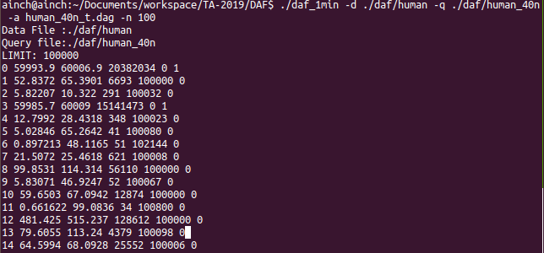
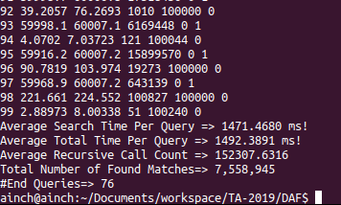
Print format
If you execute daf_1min file, then result would be like below images.

Slide 2
[graph id] [search time] [total time] [recursion time] [matching number] [is it solved ?]
( You don’t have to care “[…]” parts )
( answer for “is it solved?” -> 0 : yes / 1 : no )

Slide 3
These values are used for performance evaluation.

Slide 4
Standards for performance evaluation
Average Total time per Query ( 10 points )
Average Recursive Call Count ( 10 points )
End Queries ( 15 points )
Total 35 points for performance evaluation.

Slide 5
Average Total time per Query
[ 1000 ~ ] : 0 points
[ 800 ~ 1000 ] : 4 points
[ 550 ~ 800 ] : 6 points
[ 0 ~ 550 ] : 10 points

Slide 6
Average Recursive Call Count
[ 70001 ~ ] : 0 points
[ 50001 ~ 70000 ] : 4 points
[ 30001 ~ 50000 ] : 6 points
[ 0 ~ 30000 ] : 10 points

Slide 7
End Queries
[ 0 ~ 80 ] : 0 points
[ 81 ~ 90 ] : 10 points
[ 91 ~ 100 ] : 15 points

